Slide 1
LEAD SCORING CASE STUDY
Arjun Pujari

Slide 2
Problem Statement
X education sells online courses to Industry Professionals.
X education gets a lots of leads , its lead conversion rate it very poor. For example, if they acquire 100 leads in a day , only about 30 of them are converted.
To make this process more efficient ,the company wishes to identify the most potential leads, also known as “Hot Leads”.
If they successfully identify this set of leads, the lead conversion rate should go up as the sales team will now be focusing more on communicating with the potential leads rather than making calls to everyone.

Slide 3
Business Objective
Help X education to select the Most Promising Leads ( Hot Leads)
Build the Logistic regression model to assign a lead score value between 0 to 100 to each of the leads which can be used by the company to target Potential Leads

Slide 4
Analysis Approach
EDA and Data
Preparation
Model Evaluation
Analysing the each
variable behaviour with respect to target variable, creating dummy variables, Train-test split,
Scaling of data and RFE
Finding confusion matrix,
Accuracy along with
sensitivity and specificity.
Plotting ROC curve and
finding optimal cut-off
along with precision recall curve.
Building a Logistic
regression model
Prediction on
Test Data
Data Inspection
and Cleaning
The final prediction on
test data conveying
evaluation on the basis
of model accuracy,
sensitivity and
specificity
Building the model with features selected by RFE. Features to be eliminated
one by one having high P-values
and VIF.
Checking the information,
numerical description,
null values treatment,
and removing unwanted
columns.

Slide 5
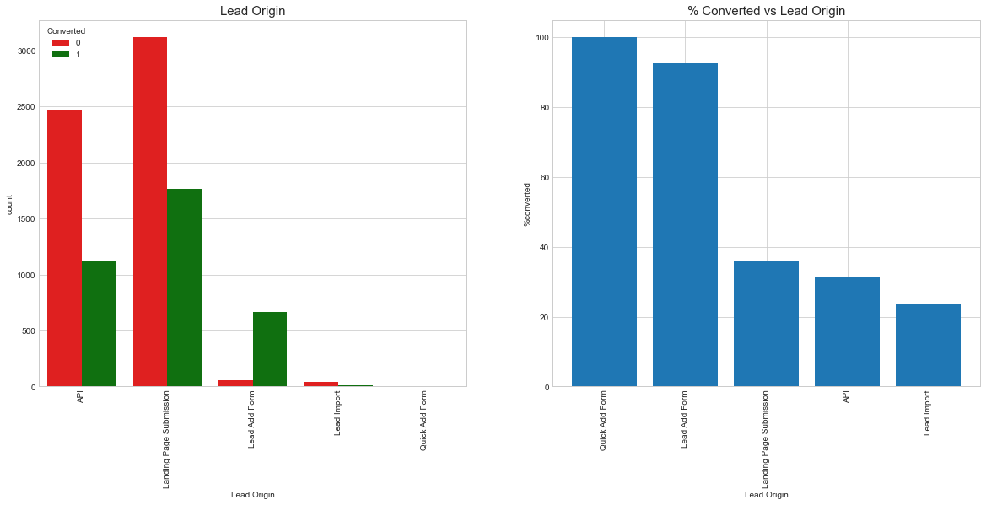
Analysis - Lead Origin
Observation: Most of the Leads originated from submissions on the landing page and followed by API, where around 30% are converted.
Leads from Quick Add Form are 100% Converted, there was just 1 lead from that category.
Leads from the Lead Add Form are the next highest conversions in this category at around 90% of 718 leads.
Lead Import are very less in count and conversion rate is also the lowest
To improve overall lead conversion rate, we need to focus more on improving lead conversion of API and Landing Page Submission origin and generate more leads from Lead Add Form

Slide 6
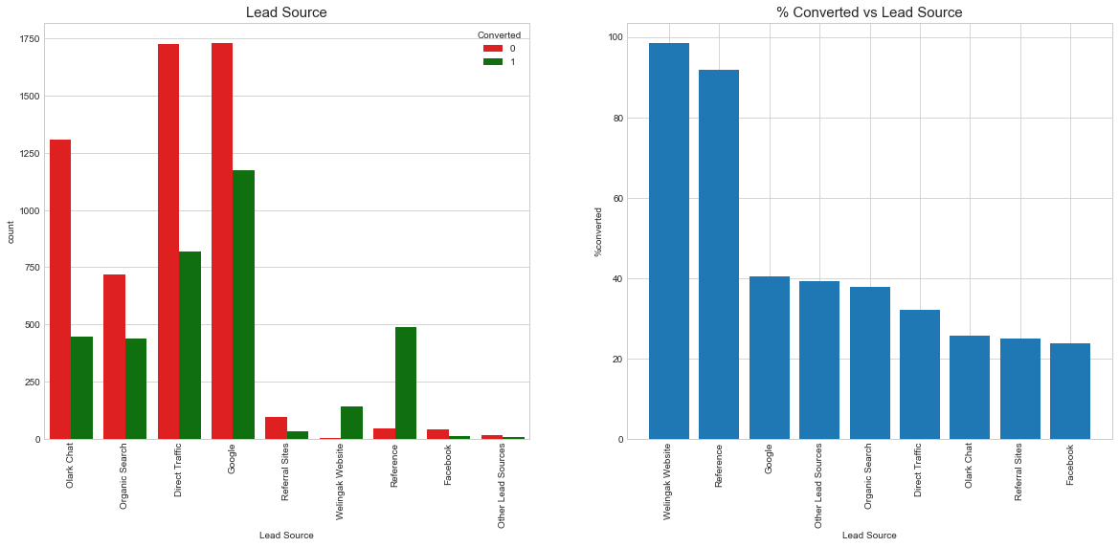
Analysis - Lead Source
Observation:
The source of most leads is Google, and 40% of the leads converted, followed by Direct Traffic, Organic search and Olark chat
A lead that came from a reference has over 90% conversion from the total of 534.
Welingak Website has almost 100% lead conversion rate. This option should be explored more to increase lead conversion
To increase lead count, initiatives should be taken so already existing members increase their referrals.

Slide 7
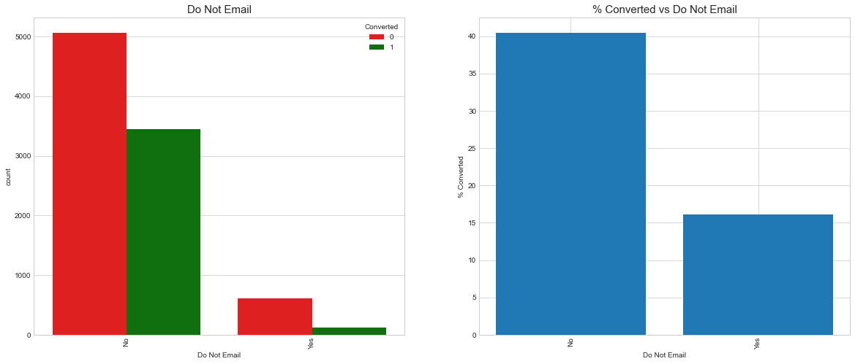
Analysis - Do Not Email
Observation:
Majority of the people want Email (~92%)
People who are ok with Email has conversion rate of 40%
People who have opted to receive Email has higher rate of conversion (40%)

Slide 8
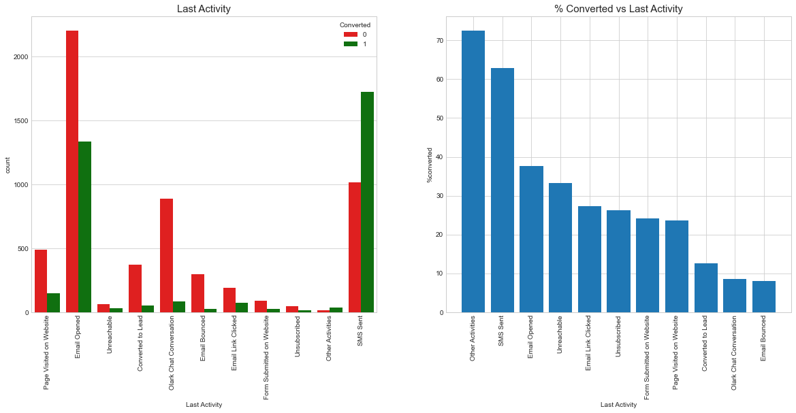
Analysis - Last Activity
Observation:
Most of the lead have their Email opened as their last activity
After combining smaller Last Activity types as Other Activities, the lead conversion is very high (~70%)
Conversion rate for leads with last activity as SMS Sent is almost 60%

Slide 9
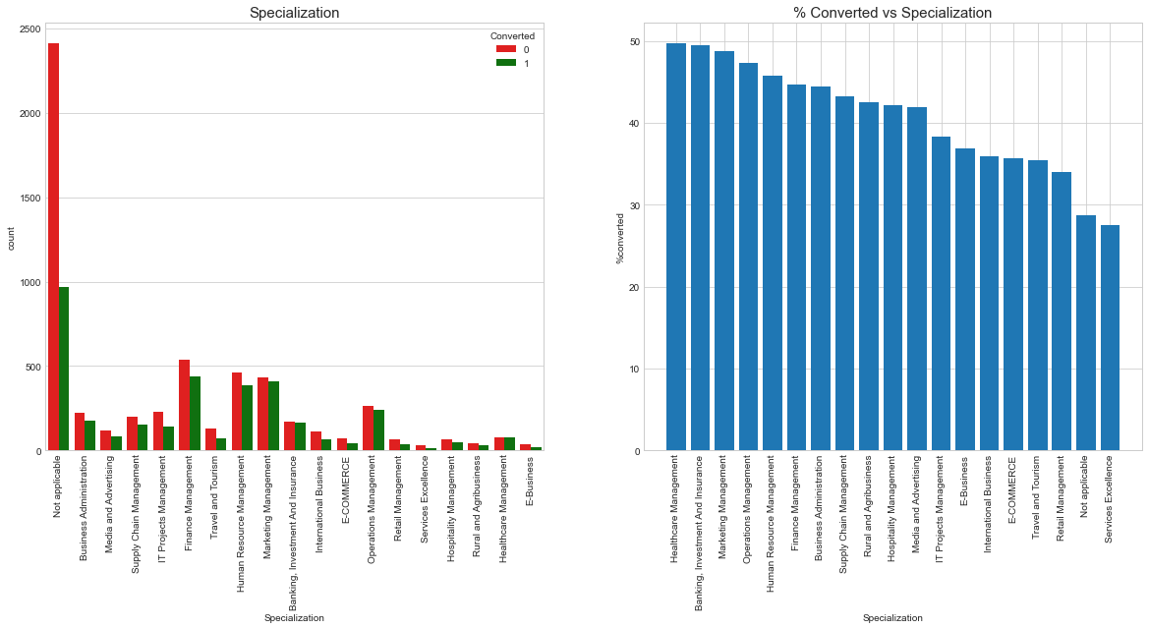
Analysis - Specialization
Observation:
Most of the leads have not mentioned a specialization and around 28% of those converted
Leads with Banking Investment and insurance and Marketing Management - Over 45% Converted

Slide 10
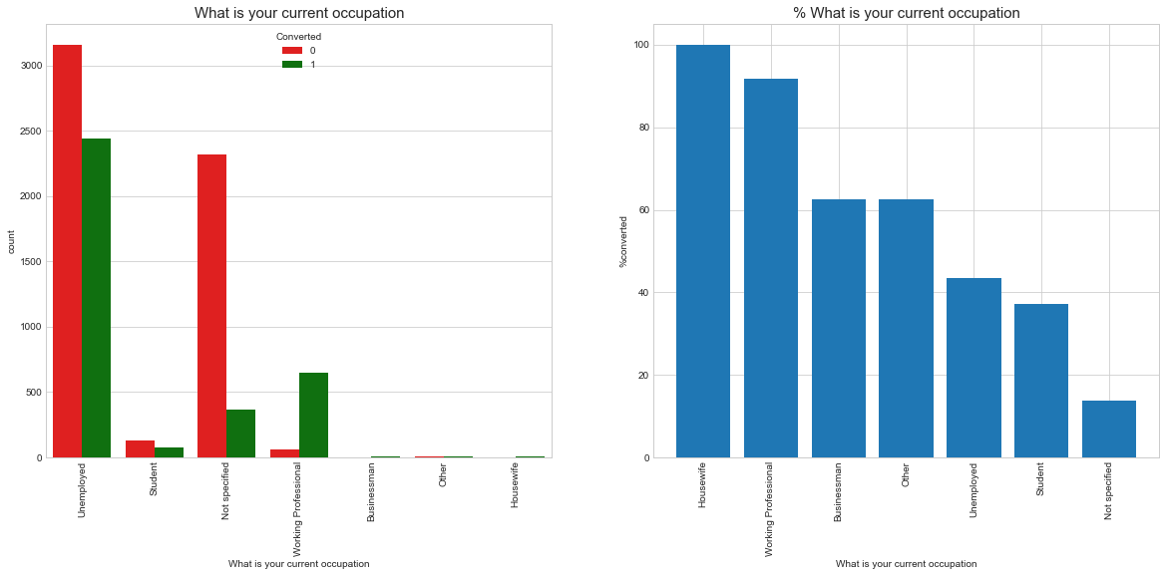
Analysis - Current Occupation
Observation:
Housewives are less in numbers, but have 100% conversion rate
Working professionals, Businessmen and Other have high conversion rate
Leads with Unemployed occupation is highest in number, but the conversion rate is low (~40%)

Slide 11
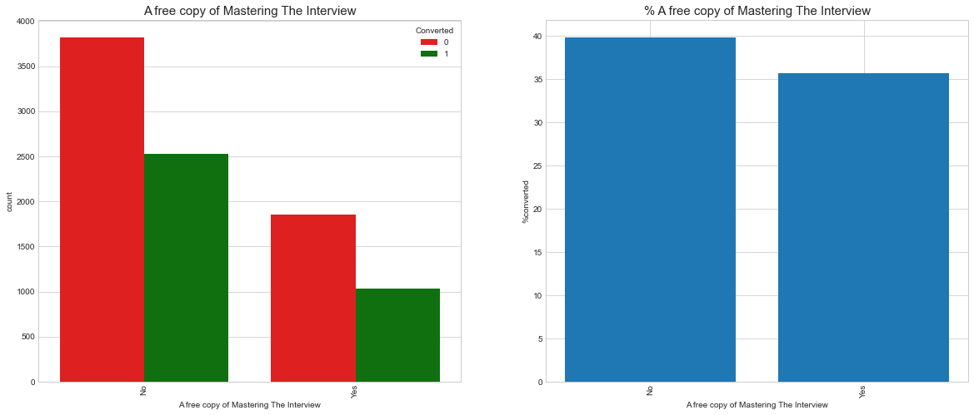
Analysis - A free copy of Mastering The Interview
Observation:
Distributing Free-Copy of Mastering Interview doesn't seem affect the conversion as the conversion rate is almost same.

Slide 12
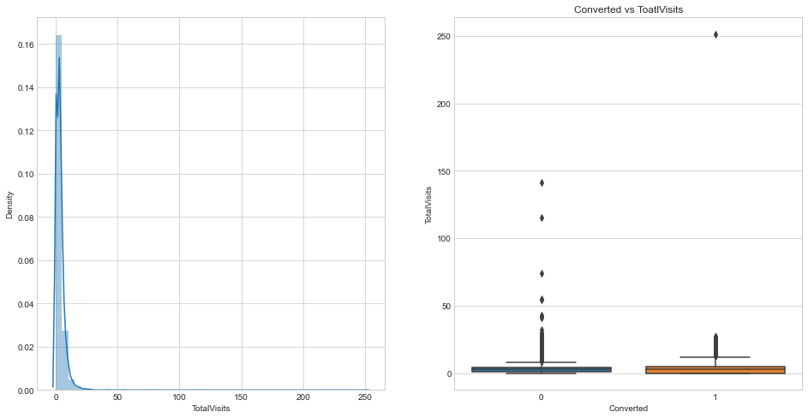
Analysis – Total Visits
Observation:
Presence of outliers in Total Visit column

Slide 13
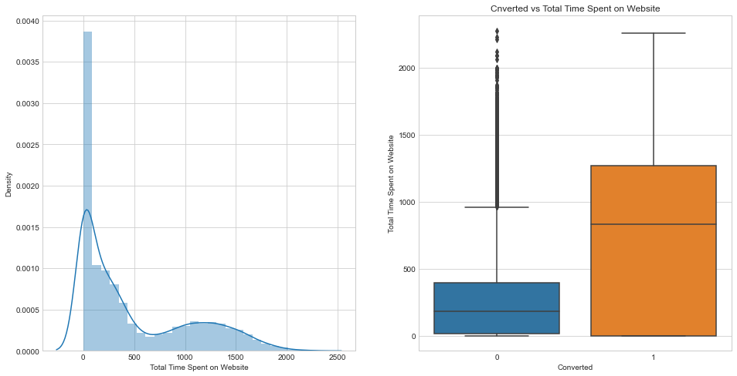
Analysis – Total Time Spent on Website
Observation:
Presence of outliers in Total Time Spent on Website column
Leads spending more time on the website are more likely to be converted

Slide 14
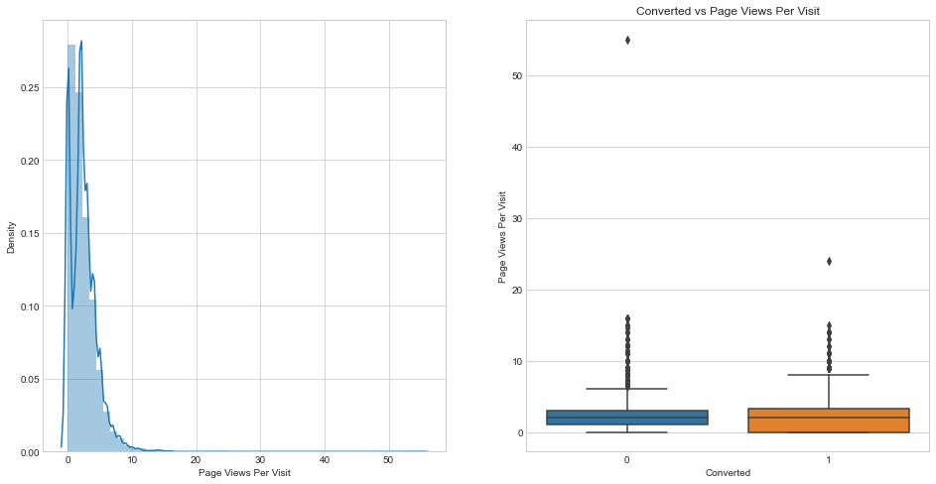
Analysis – Page Views Per Visit
Observation:
Presence of outliers in Page Views Per Visit column

Slide 15
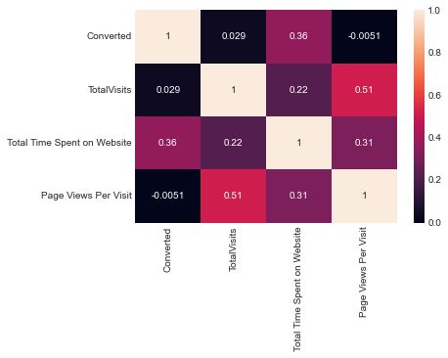
Analysis- Multivariate
Observation:
Total Visits has positive correlation with Page views per visit

Slide 16
Model Evaluation – Train Data
0.335
Probability Threshold
Accuracy
Sensitivity
Specificity
AUC
F1 Score
80.55
80.29
80.70
0.88
75.89
Recall
Precision
Positive predictive
value
Negative predictive
value
80.29
71.94
71.94
86.92

Slide 17
Model Evaluation – Test Data
0.335
Probability Threshold
Accuracy
Sensitivity
Specificity
AUC
F1 Score
80.48
80.09
80.73
0.88
76.42
Recall
Precision
Positive predictive
value
Negative predictive
value
80.09
73.08
73.08
86.13

Slide 18
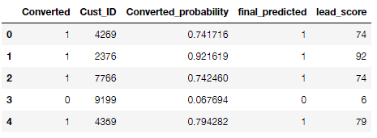
Final Prediction
Top 5 Records
Lead Score = 100 * Conversion Probability
•Higher the lead score, higher is the probability of a lead getting converted and vice versa,
•Since, we had used 0.334 as our final Probability threshold for deciding if a lead will convert or not, any lead with a lead score of
33.4 or above will have a value of ‘1’ in the Final predicted column.

Slide 19
Feature Importance
Do Not Email - 1.26
Total Time Spent on Website 1.09
Lead Origin_Landing Page Submission - 0.25
Lead Origin_Lead Add Form 3.42
Lead Source_Olark Chat 0.98
Lead Source_Welingak Website 1.99
What is your current occupation_Working Professional 2.84
Last Activity_Email Opened 0.66
Last Activity_Olark Chat Conversation - 0.87
Last Activity_SMS Sent 1.78
Last Activity_Unreachable 0.84
Last Activity_Unsubscribed 1.25
Top three variables in our model that contribute most towards the probability of a lead getting converted
Lead Origin_Lead Add Form
What is your current occupation_Working Professional
Lead Source_Welingak Website

Slide 20
Conclusion
To improve overall lead conversion rate, focus should be on improving lead conversion
of olark chat, organic search, direct traffic, and Google leads and generate more leads from
reference and welingak website.
Lead conversion rate, can be improved by focusing more on improving lead conversion
of API and Landing Page Submission origin and generate more leads from Lead Add Form
Though Google is the highest source to get leads, the lead conversion through Google
is low comparatively.
Focus on Working Professional which has high conversion
Website should be made more engaging to make leads spend more time
Improve the Olark Chat service since this is affecting the conversion negatively

